Slide 1
Analysis of Weather Data and Opinion on Climate Change
TEAM MEMBERS:
Bharat Khandelwal
Mike Sanders
Satya Phanindra Kumar Kalaga
Will Kimbal

Slide 2
Background
Climate change impacts us all.
However, some individuals have trouble believing that climate change is occurring.
This may be because people experience weather changes more frequently than climate change.
The Climate Change in the American Mind: National survey data on public opinion (2008-2022) attempts to determine the factors related to failing to believe climate change is happening.
The survey does not include data on individual’s weather experience.

Slide 3
SMART Questions
1) How have global temperature changes impacted US opinion of the existence of climate change since 2000?
2) How has temperature and rainfall impacted the perception of climate change occurring in individuals in the US since 2000?
3) How has the El Nino/La Nina weather pattern impacted public perception of climate change since 2000?
4) How have local weather patterns impacted the perceptions of climate change among different demographic groups since 2000?
5) How has extreme weather impacted public perception of climate change since 2000?

Slide 4
Our Dataset
Primary Source: Yale Program on Climate Change Communication (YPCCC) & George Mason University Center for Climate Change Communication (Mason 4C). (2020). Climate Change in the American Mind: National survey data on public opinion (2008-2022) [Data file and codebook]. doi: 10.17605/OSF.IO/JW79P
Secondary Sources: NOAA Now Data, OpenFEMA, NOAA Climate Prediction Center, NASA Climate

Slide 5
Understanding the Dataset
28 columns | Years 2008-2022
31,136 rows | 9 regions/cities
10 categorical variables | 4 data sources
YPCCC
NOAA
FEMA
NASA
Independent
Location
Demographic
City Weather
El Nino Pattern
Disaster/storm
Global Temp

Slide 6
Cleaning the Dataset
YPCCC
Selected key variables
NOAA
Weather data hand coded (copy paste from websites)
Rolled up to year
FEMA
data rolled up to region and year
N/A coded to 0
NASA
Merged by year

Slide 7
Cleaning the Dataset
(Will’s part)

Slide 8
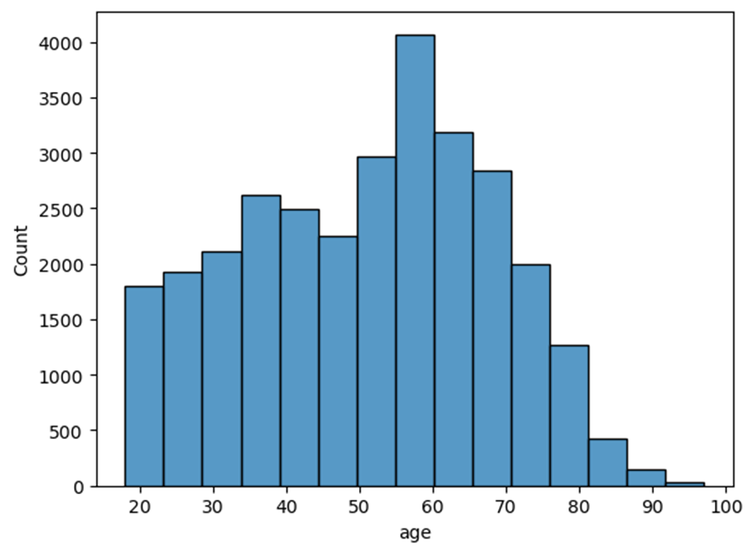
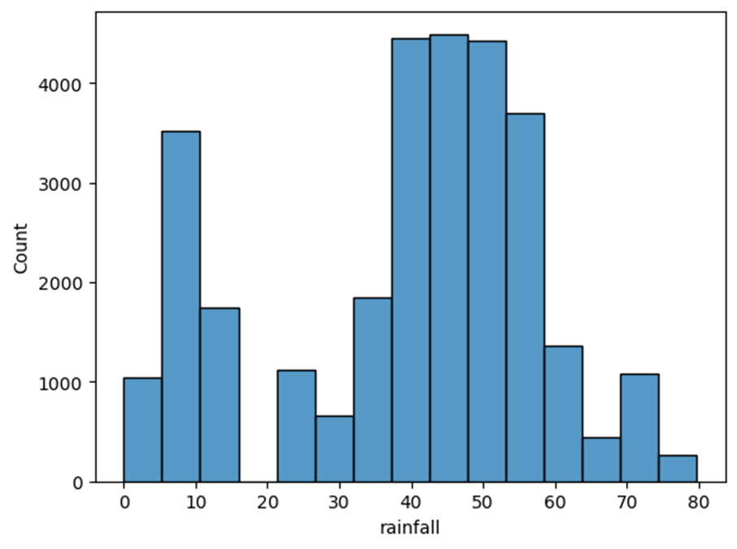
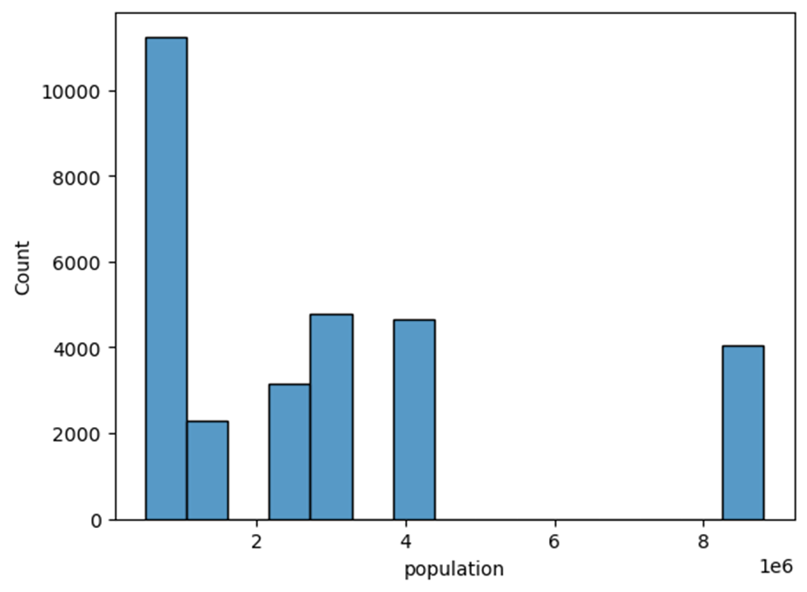
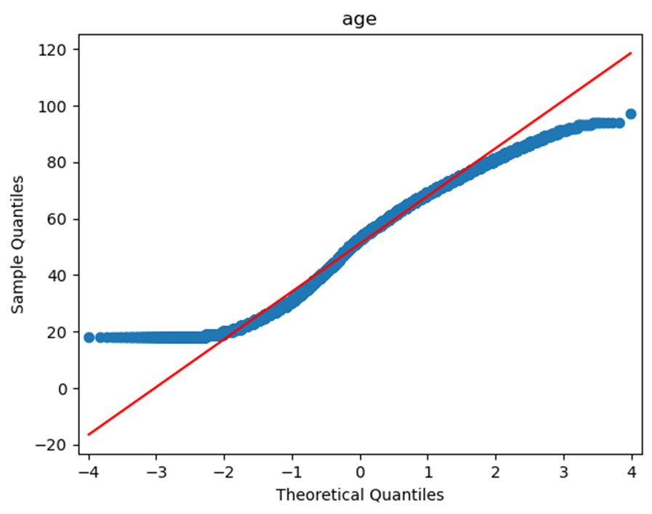
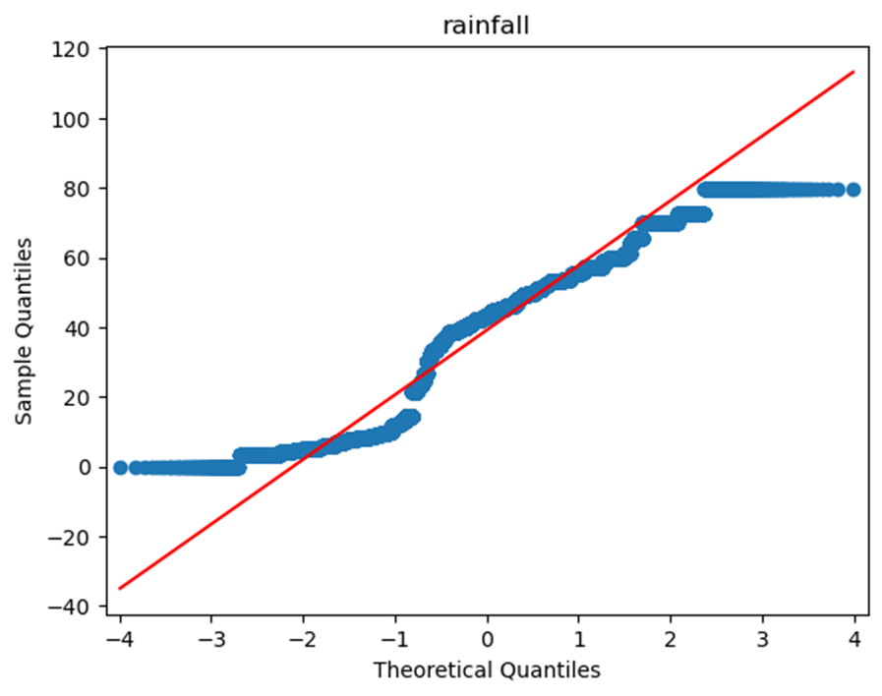
EDA - Visualizations

Slide 9
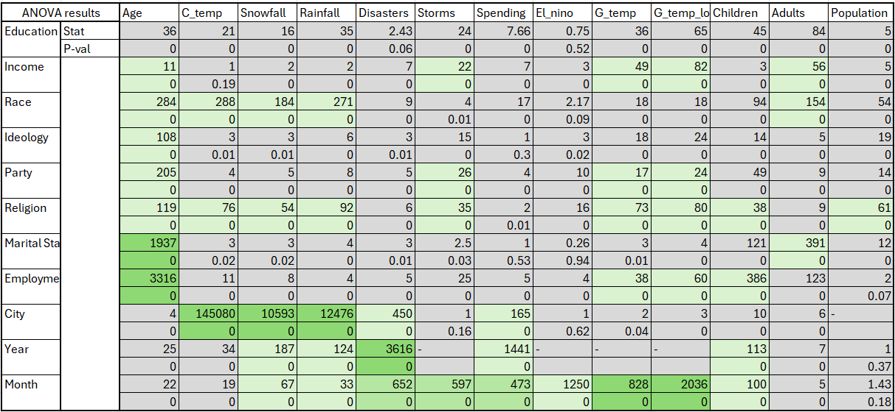
EDA - Statistical Tests (colored by effect size)

Slide 10
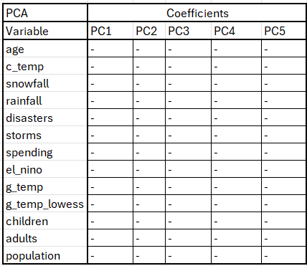
EDA - PCA
**Will fill in table tonight/tomorrow

Slide 11
EDA - cont.

Slide 12
Modeling
With the available clean data we try to build a logit model that would examine how weather patterns have impacted the perception of climate change across the US.
The output variable is boolean

Slide 13
Conclusion

